Slide 1

Piano App Integration

Slide 2
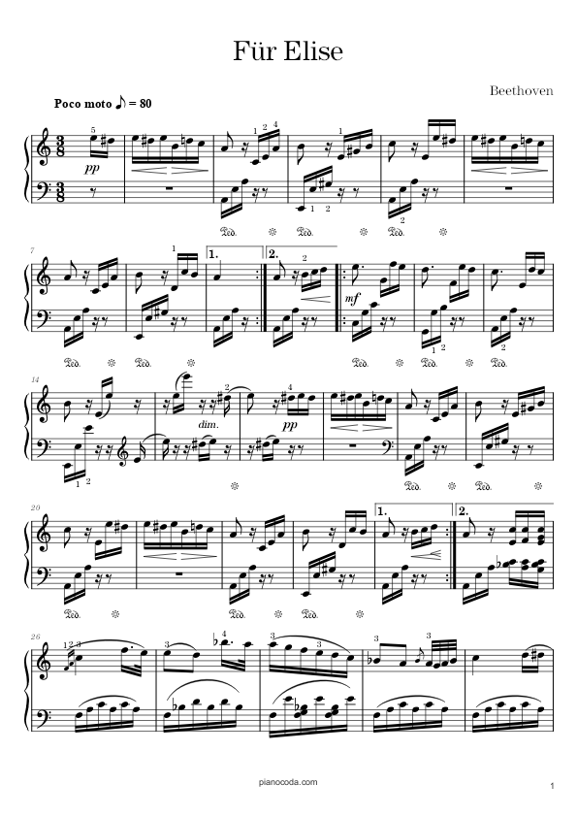
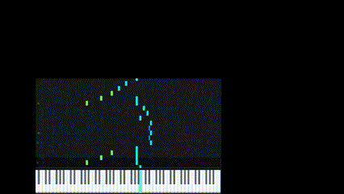

Assignment – What was it?
Automate a process that converts sheet music into a visual medium.
An accesible tool for all users no matter prior knowledge

Slide 3



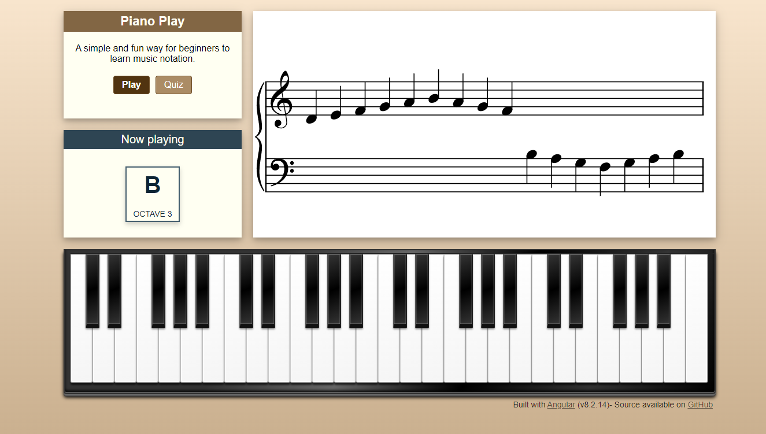
Startoff point:
Introduction to Angular
Visual piano in Angular
Work in/with different projects

Slide 4
Initial idea (roadmap)
1
Turn PDFs into PNGs
3
2
Format and translate/convert the output into a readable list
5
Have a script decipher and analyze said PNGs
Run the code and color the keys according to given sequence
4
Have a third-party component able to visualize it

Slide 5
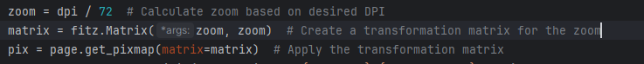
Turning PDF to PNGs
Simple process thanks to matrix library
Converts each page of a PDF into a PNG
DPI dictates the resolution (quantity of pixels)

Slide 6
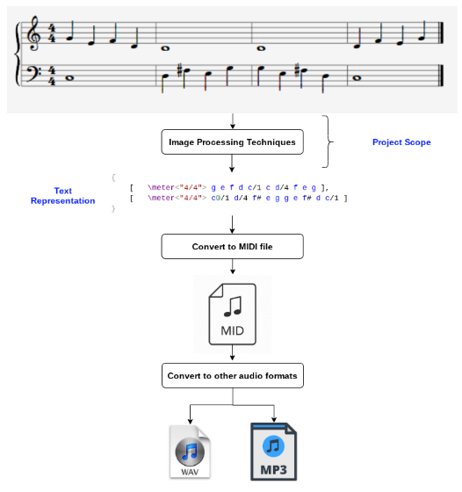
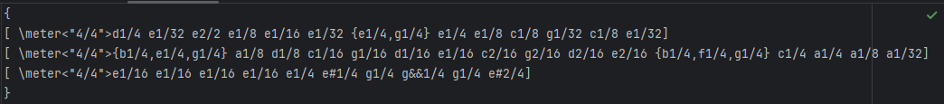
Optical Music Recognition (OMR)
Meant to turn symbols into a readable language
I used the Github repo – Mozart:
Output:

Slide 7
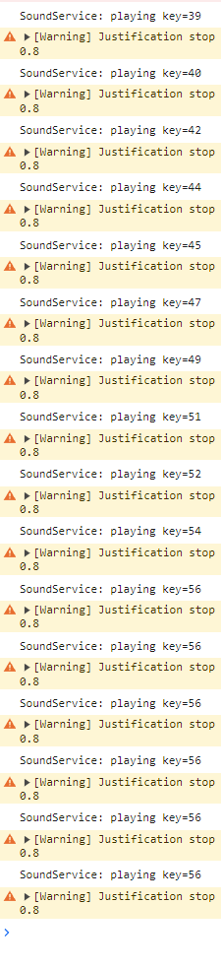
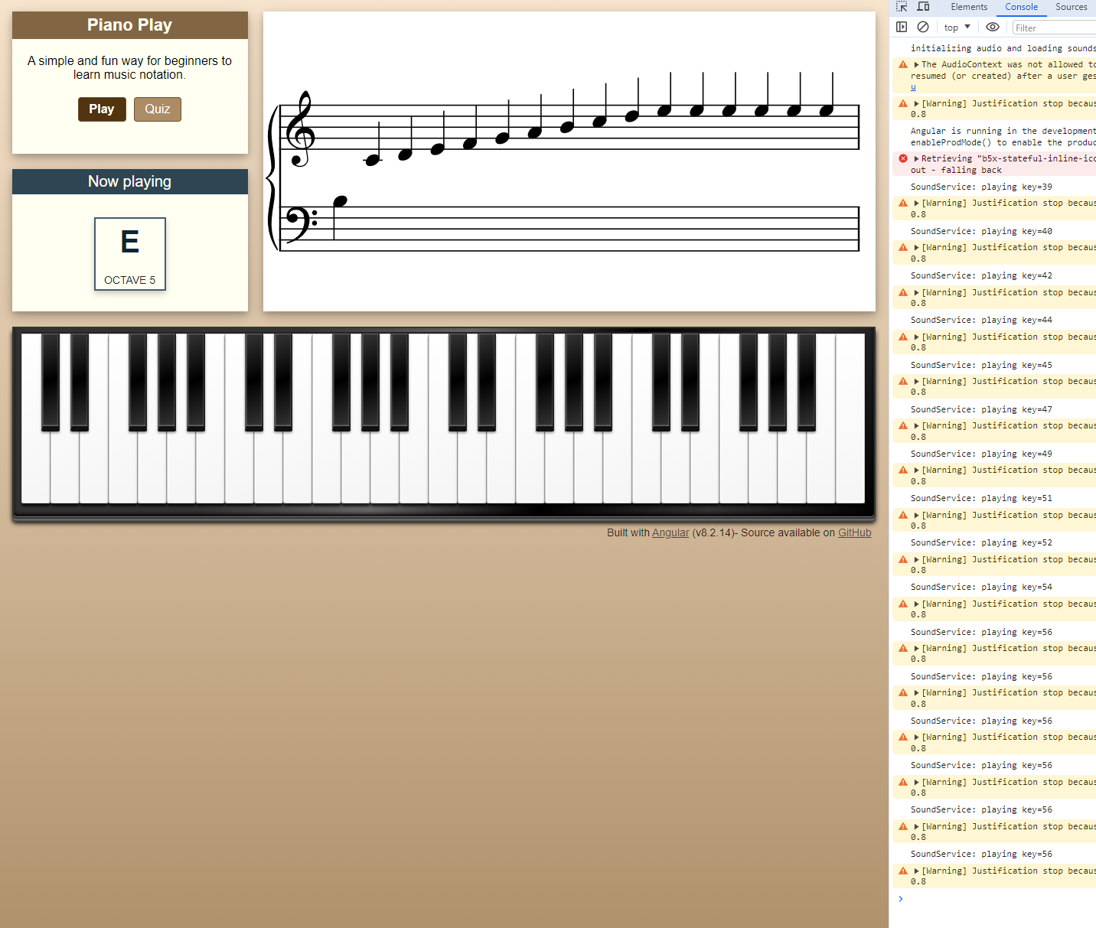
Readable format
Every note has an equivalent key value
Therefore, if I have a
sequence of notes,
I can play the ones
affiliated with said key

Slide 8
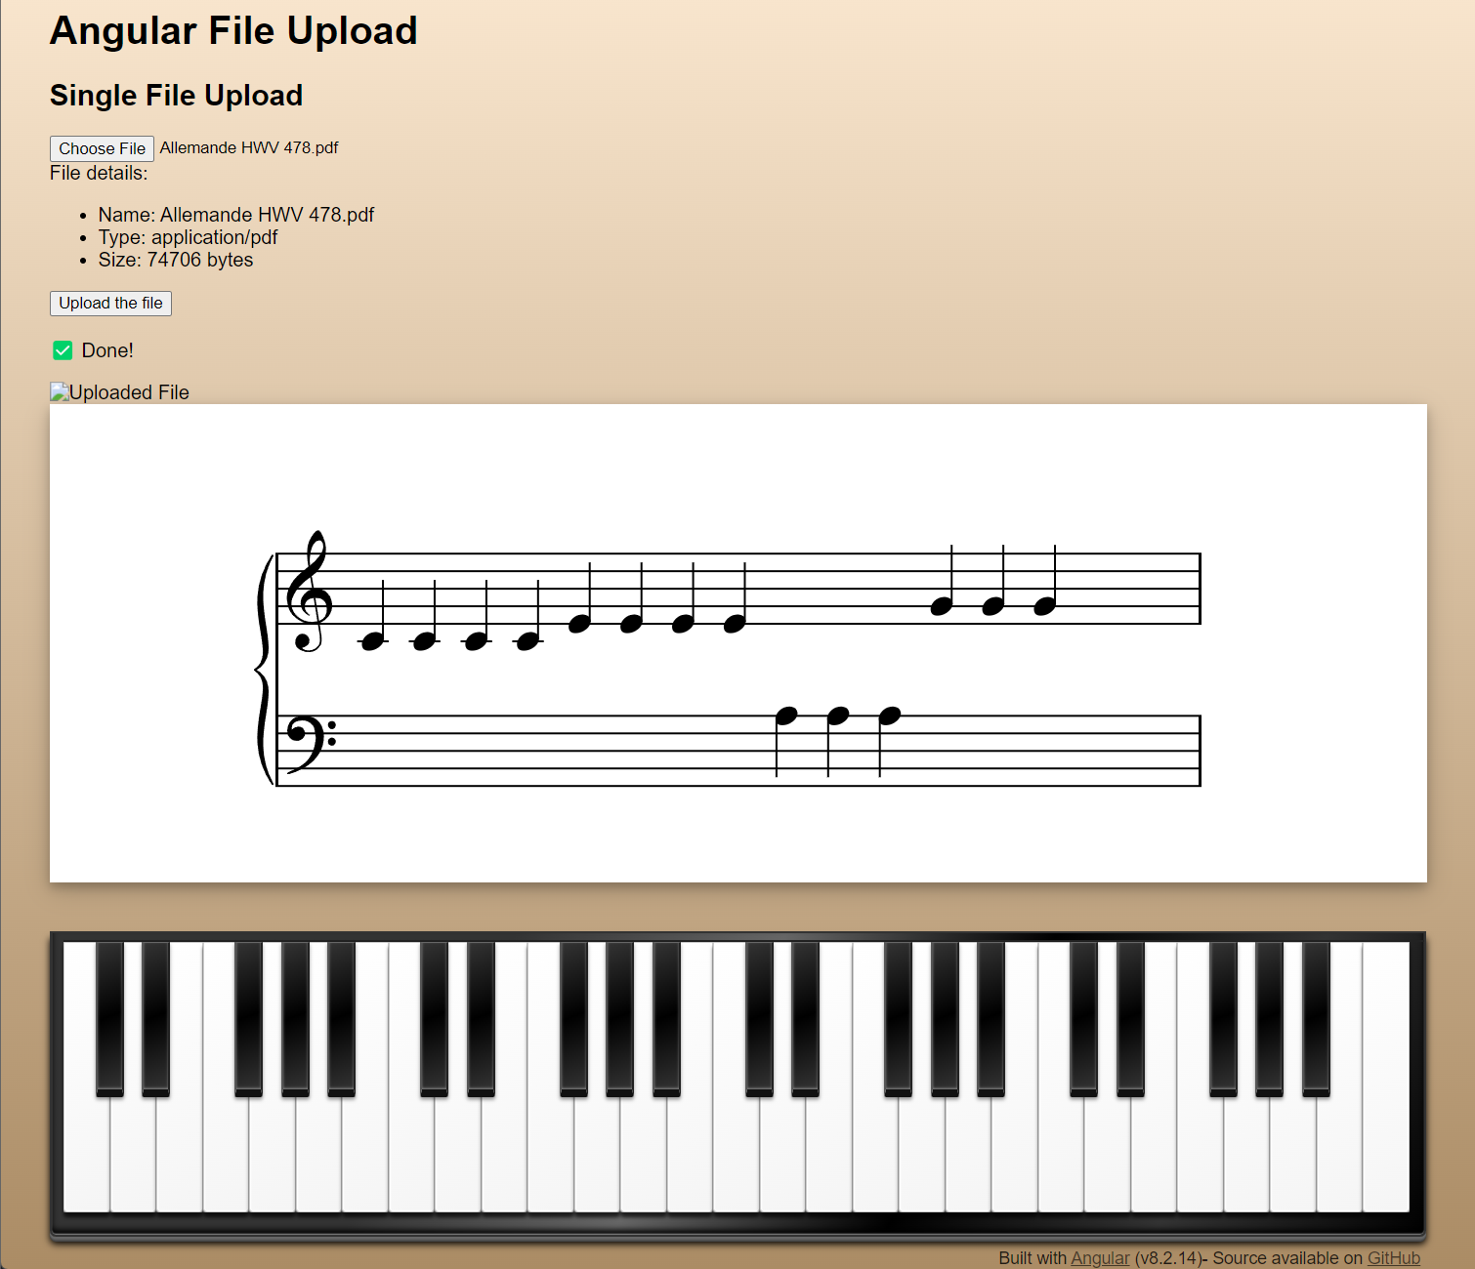
Customizing
Introduced to Typescript and frontend
Adjusted the site and removed functions not necessary
Added a file upload, used a seperate server as an intermediate.

Slide 9
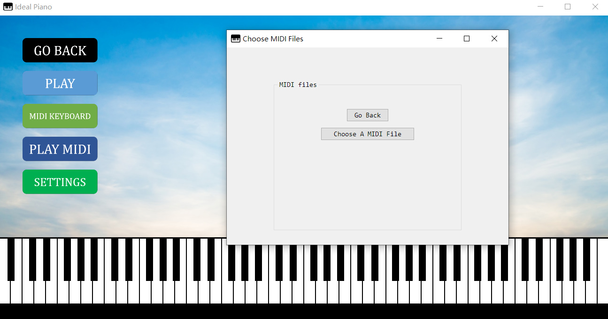
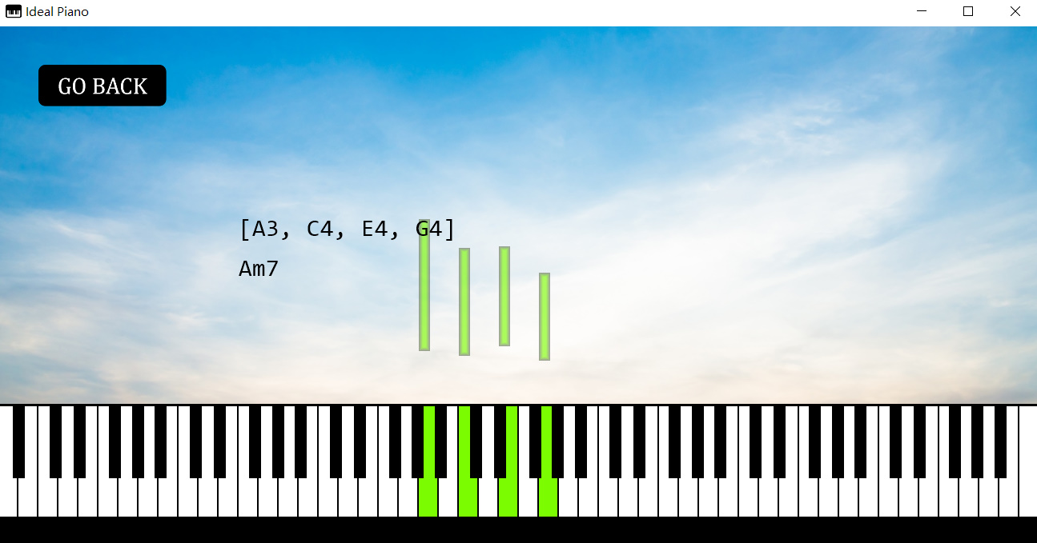
Visualization and reading
Ideal Piano:
Open source and in Pyton
Reads data from MIDI files. A sequence of values meant for distributing musical arrangements

Slide 10

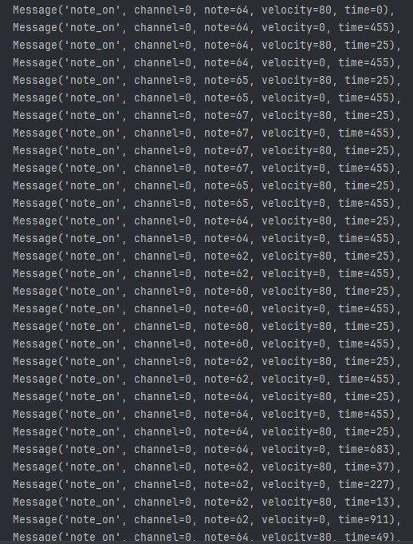
MIDI files - Formating
note_on: Usually the MIDI files require both on and off commands but ideal piano simplifies this by removing ”note_off”
channel: Chosen instrument
note: Assigned to numerical value
velocity: Volume, if it’s 0 that means
it is tied to the subsequent note
time: The note’s duration

Slide 11
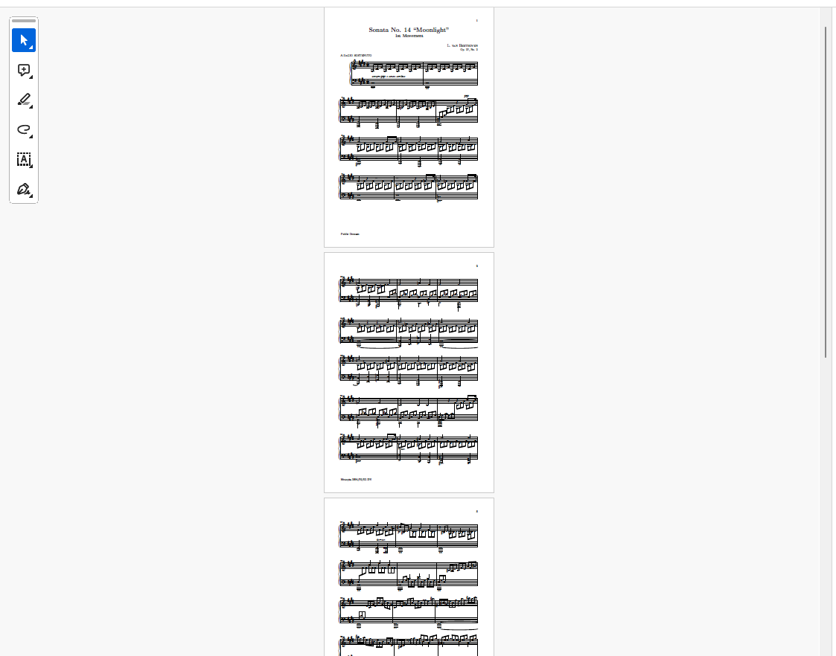
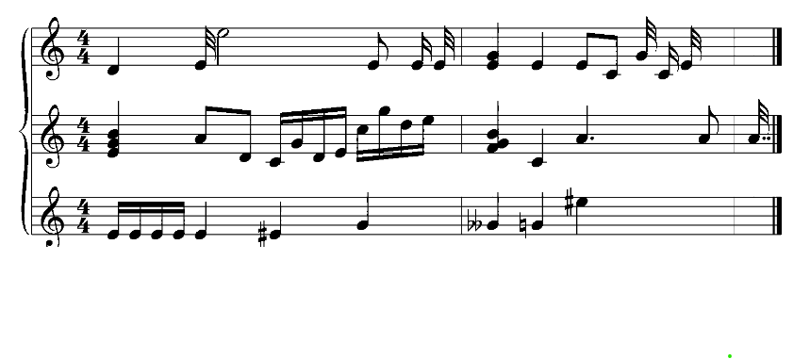
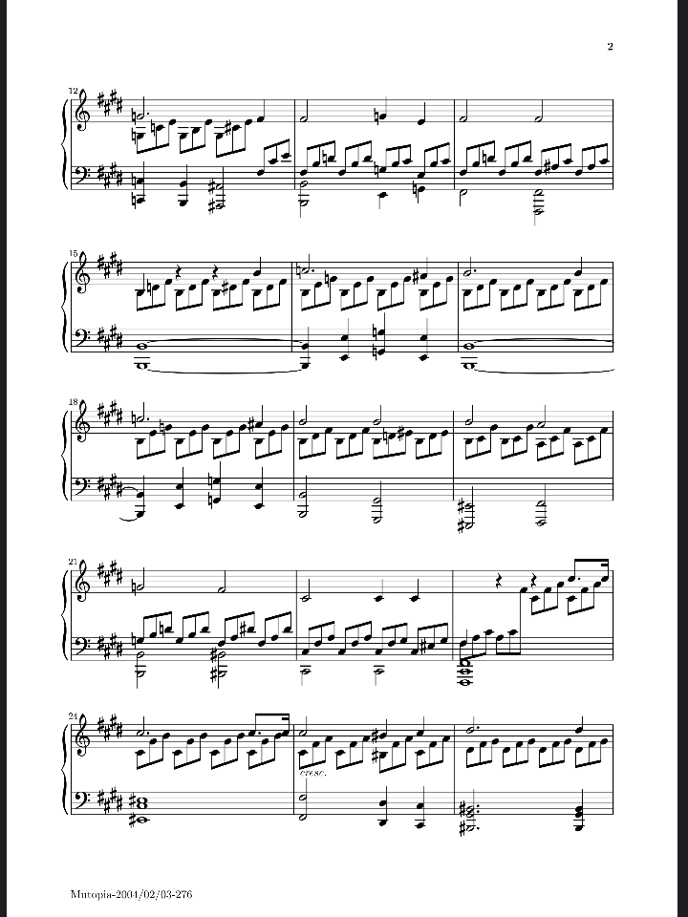
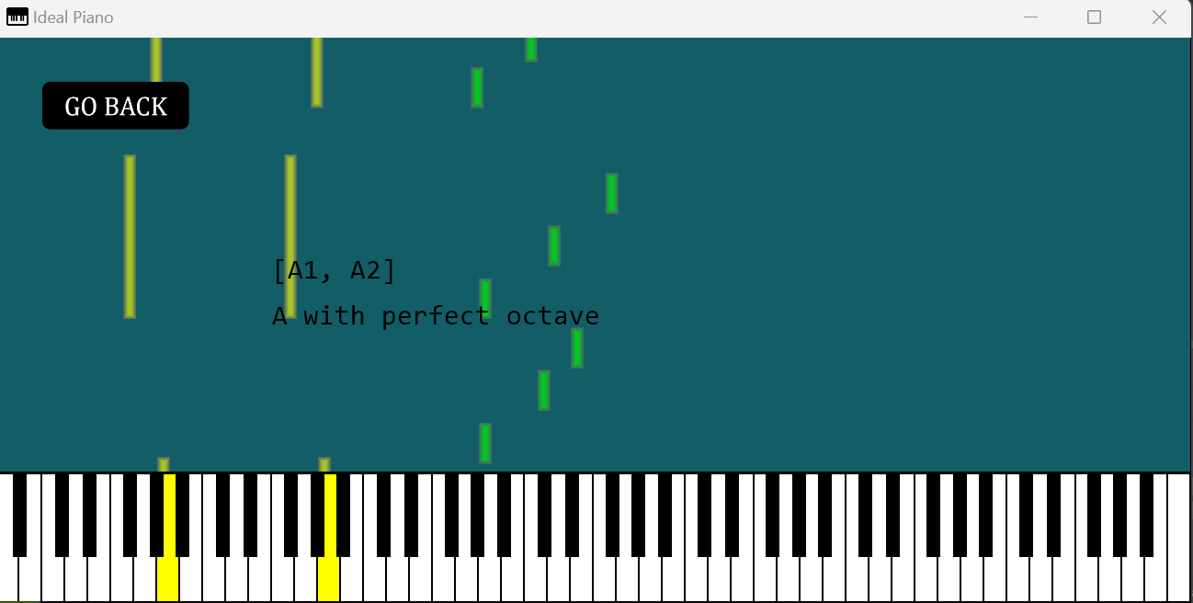
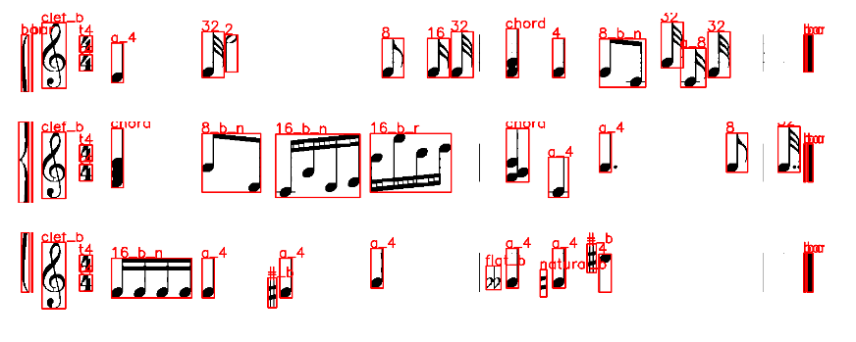
Process
Format the output the same as a MIDI
Insert the list into the visual medium
Transcribe the PNGs
Convert a PDF into several PNGs

Slide 12
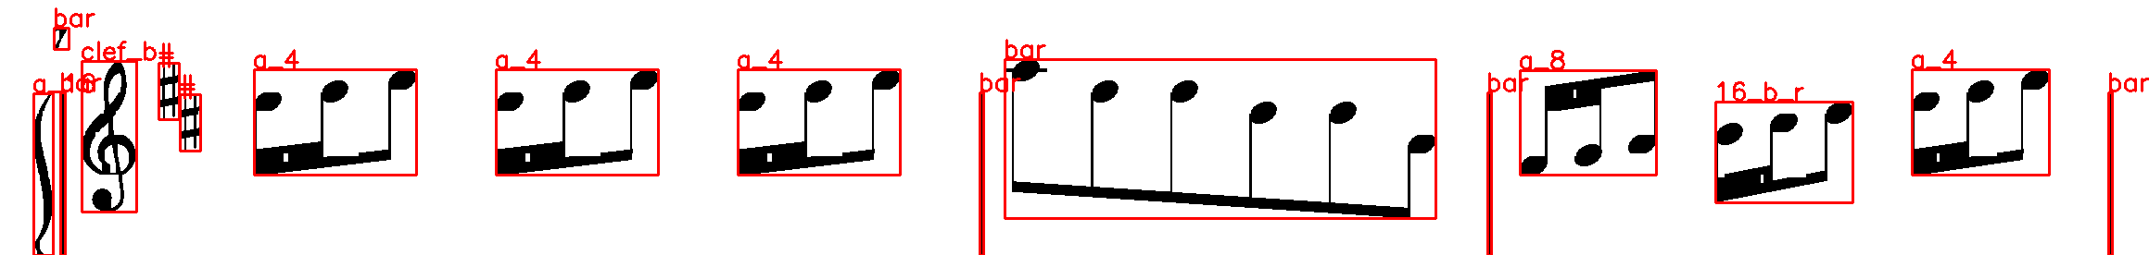
Issues and eventual realization
Mozart, my analytical tool was faulty and requiered high resolution, low sample sizes for it to give concrete results.
Nor did it specify the pauses between notes, thus giving me a constant stream of notes without reprieve.

Slide 13
Time constraint
Time optimisitc
Inexperience
Compatability

Slide 14


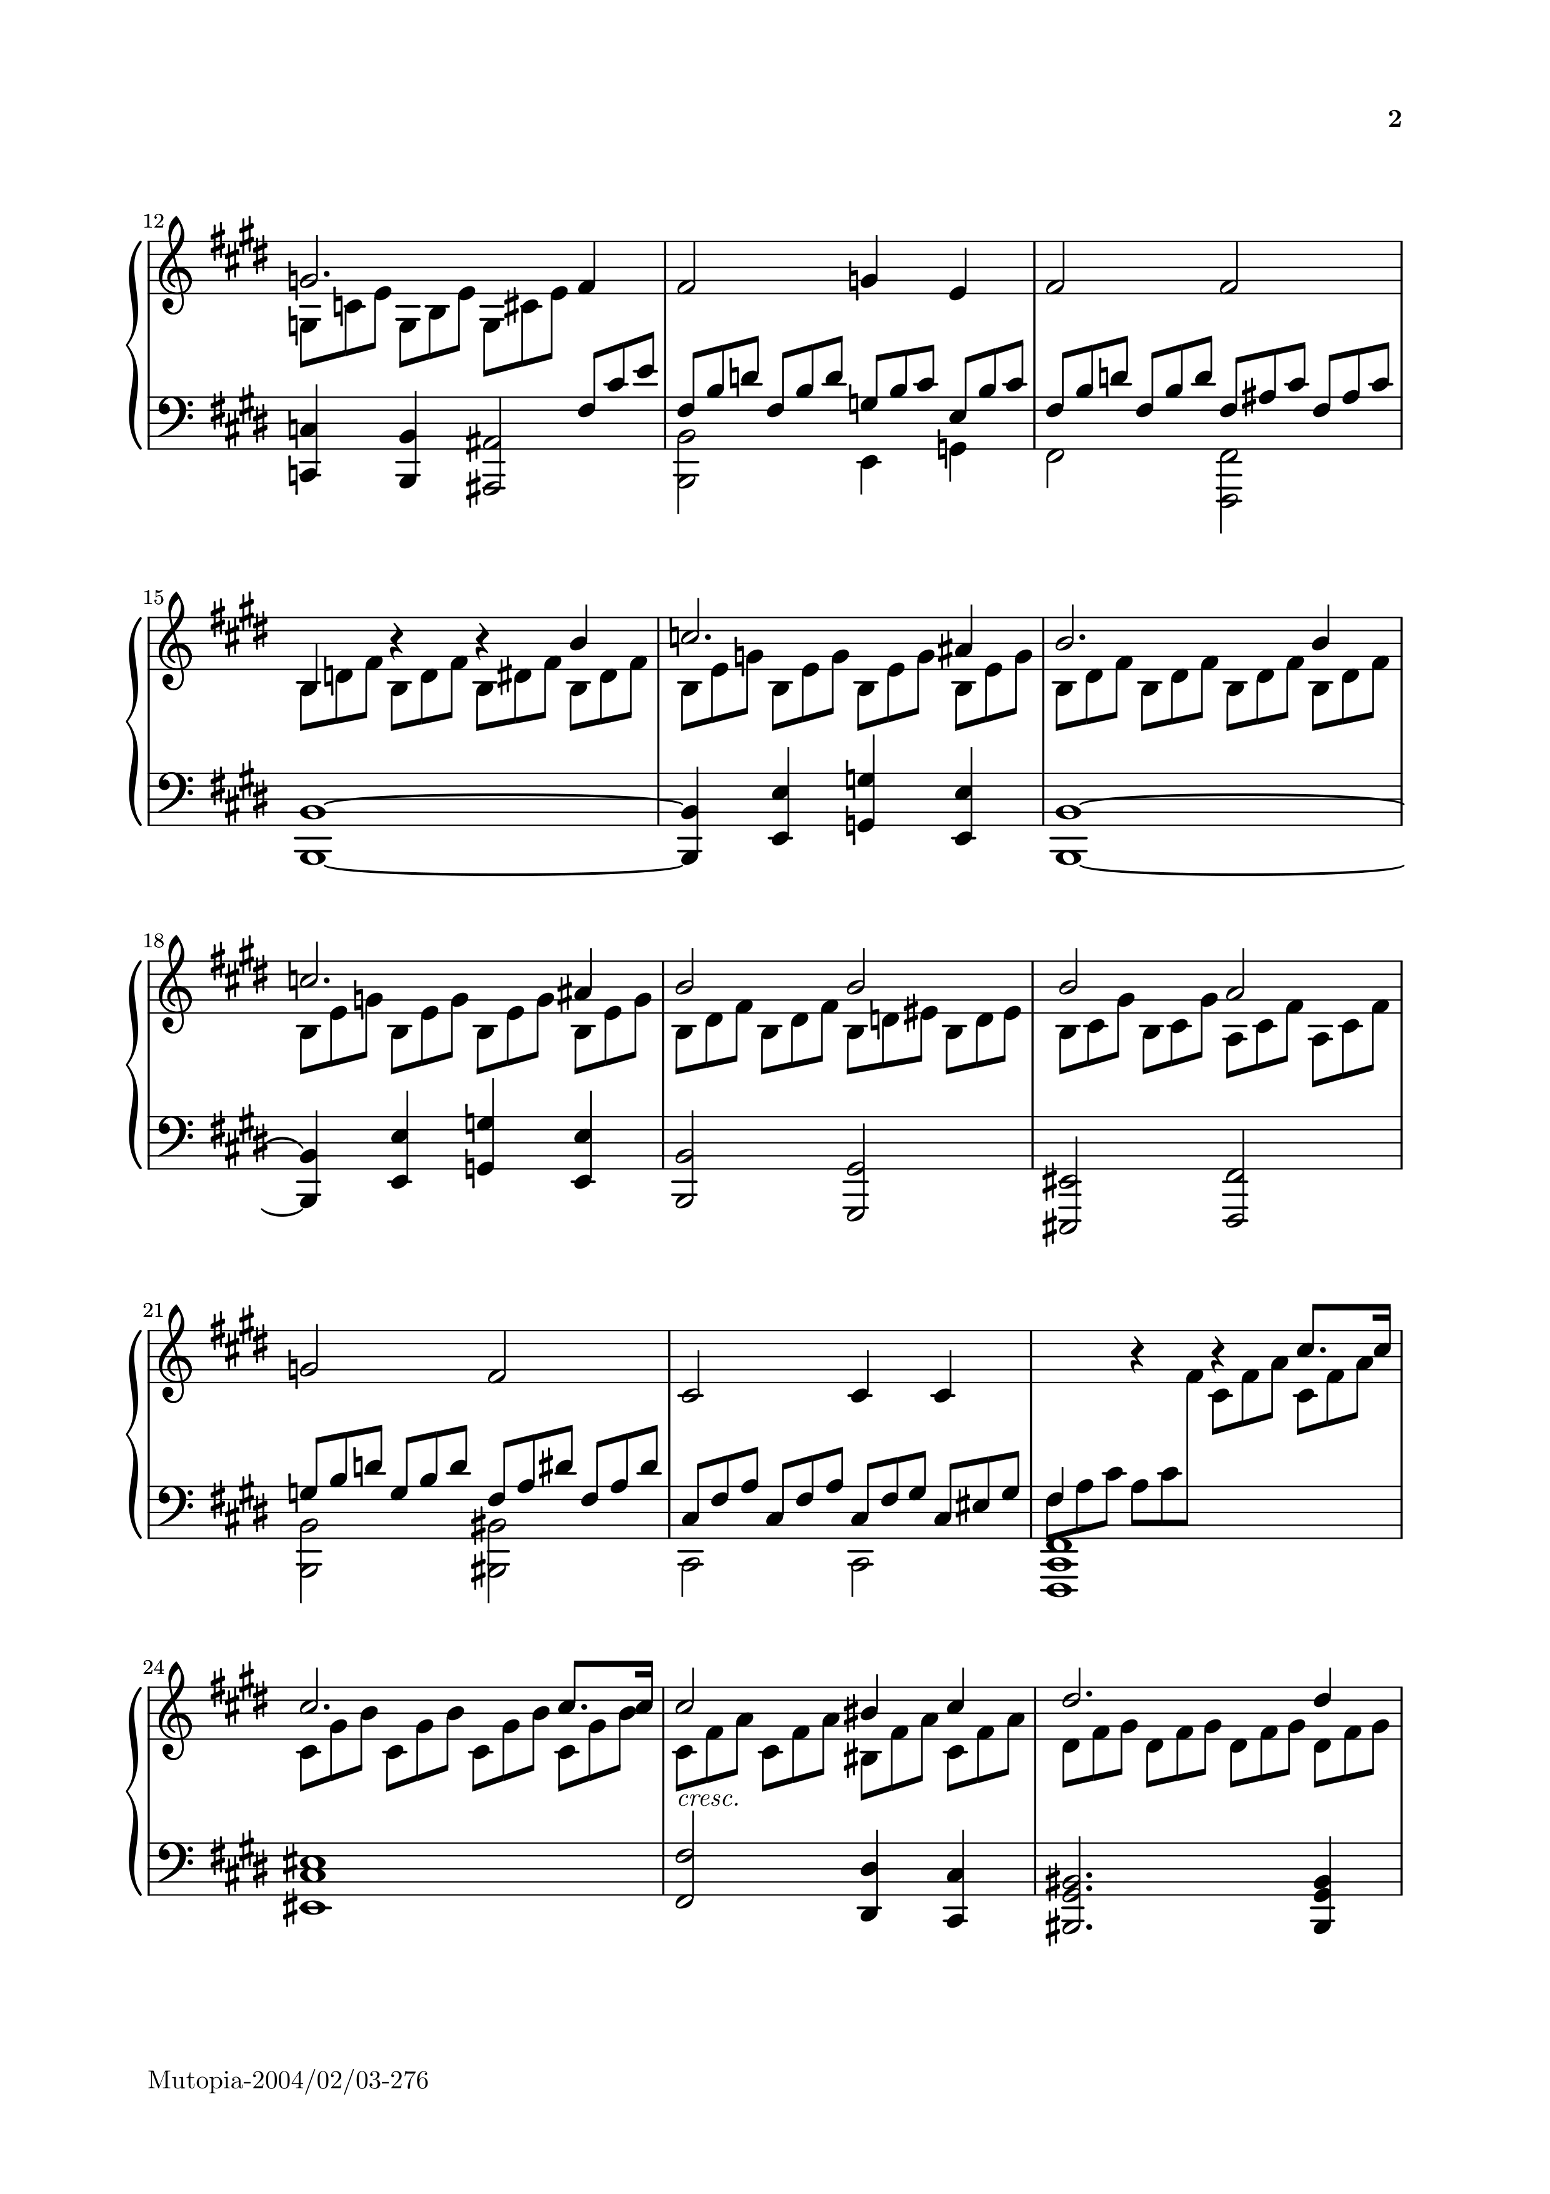
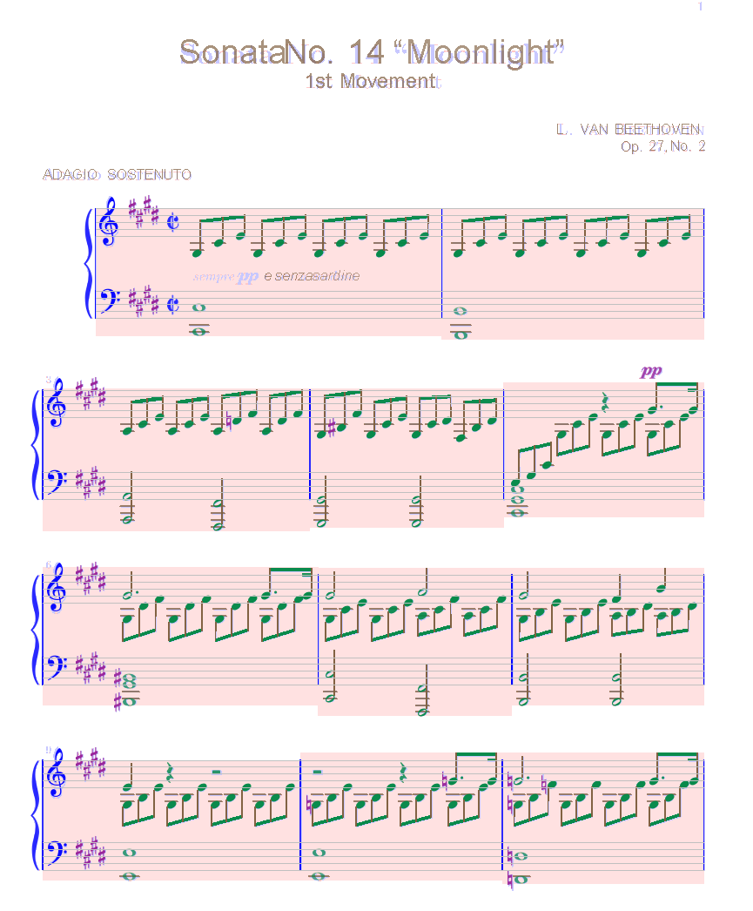
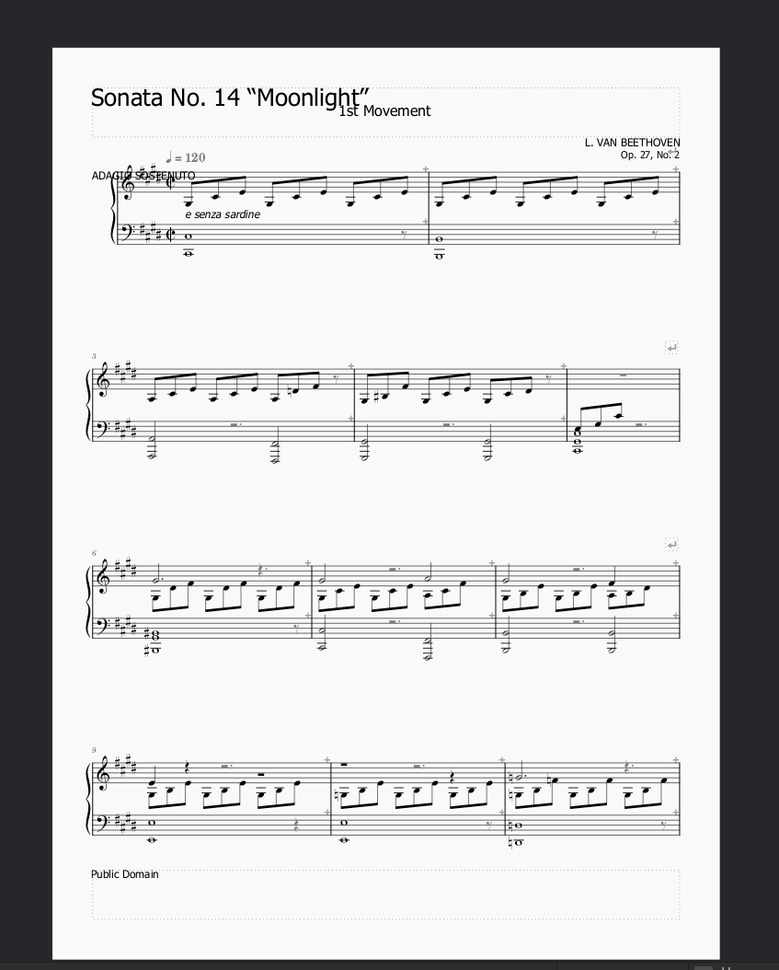
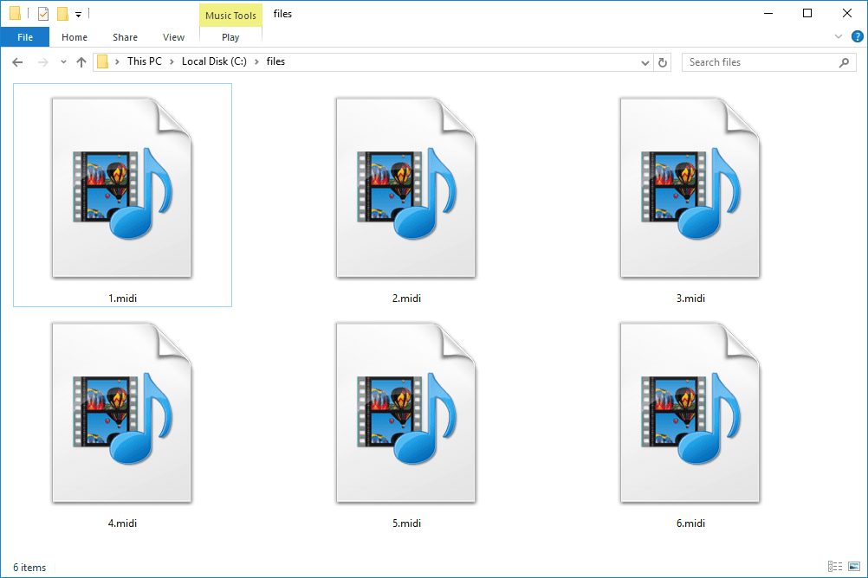
Alternative solution
PNG
Audiveris, third party, transcribes the png and exports them as MXL files
Musescore 4 interprets and exports MXL files as MIDIs
Merge all MIDI files depending on the number of pngs

Slide 15
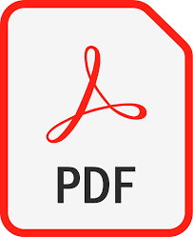
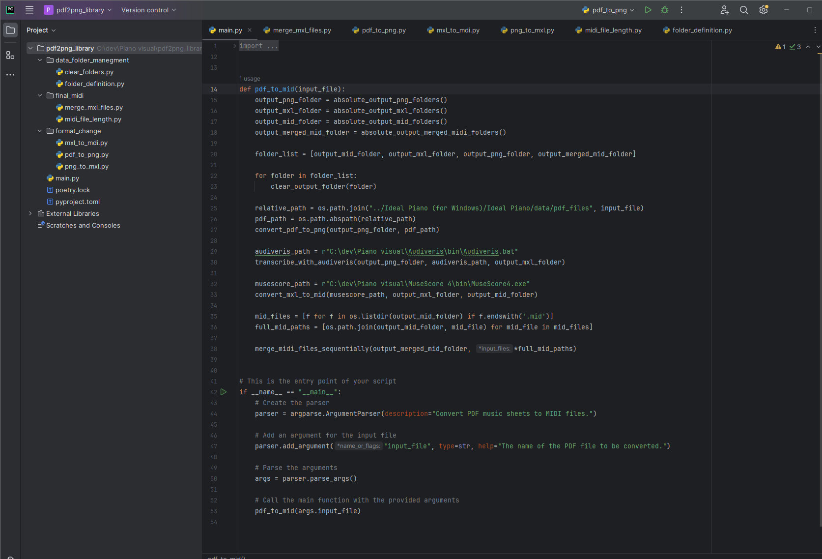

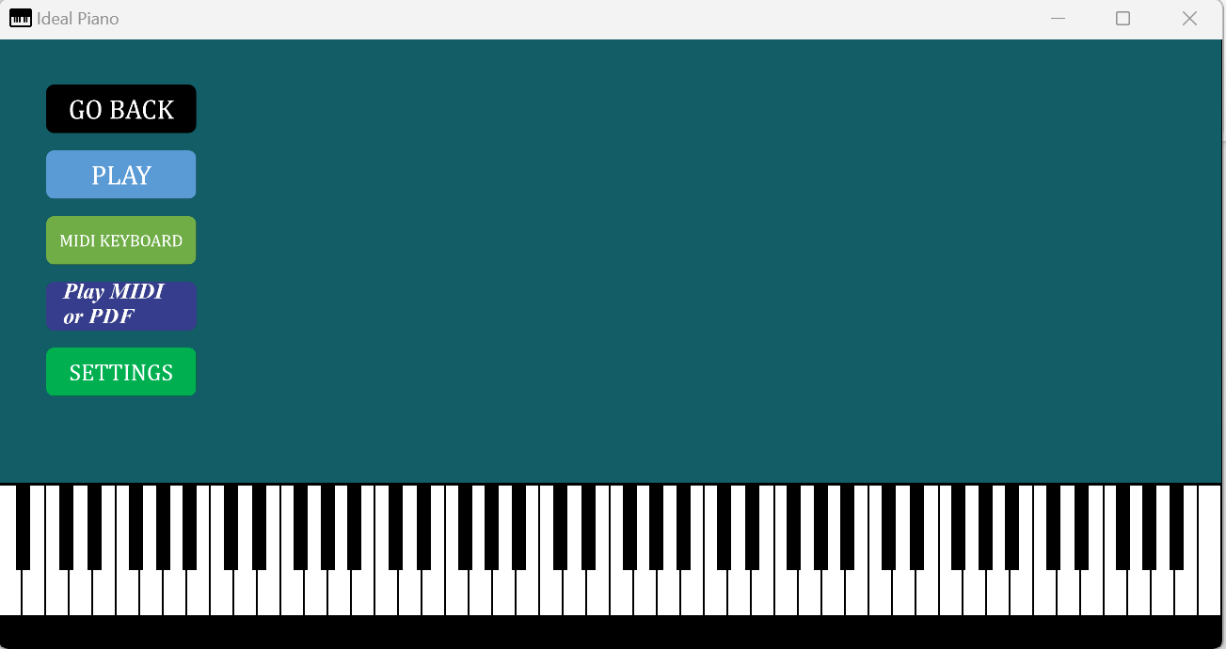
Automation progress
User submits a PDF into ideal piano
PDF turns into several PNGs
Merges all MIDI files
PNGs -> MXLs
A PDF file is imported, then exported to a conversion process, and subsequently returned as a MIDI file
MXLs --> MIDIs

Slide 16
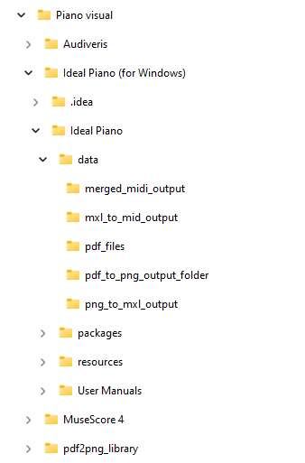
Outlay of the project:
Whole project is called ”Piano visual”
Contains all applications necessary
Data folder contains all individual components:
- PDF,
- PNGs,
- MXLs,
- MIDIs,
- Merged MIDI

Slide 17
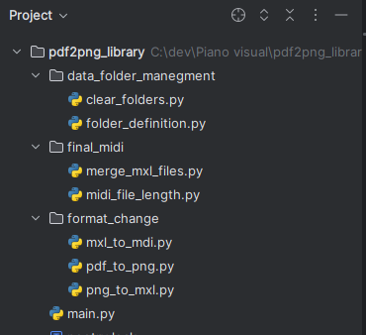
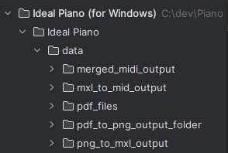
Refrencing
Conversion Project
Ideal piano (visualization)
All output is stored and refrenced in the ideal piano project.
Defining a folder path, converting the content, storing the output and then repeating the process

Slide 18
Implementation
File name
PDF in name?
First it defines the name of the file If it contains ’pdf’ in it’s name the conversion process is initiated
Then it returns a MIDI so that the code can continue as usual
Yes
Start conversion
No
Conversion to MIDI
Submitted MIDI

Slide 19
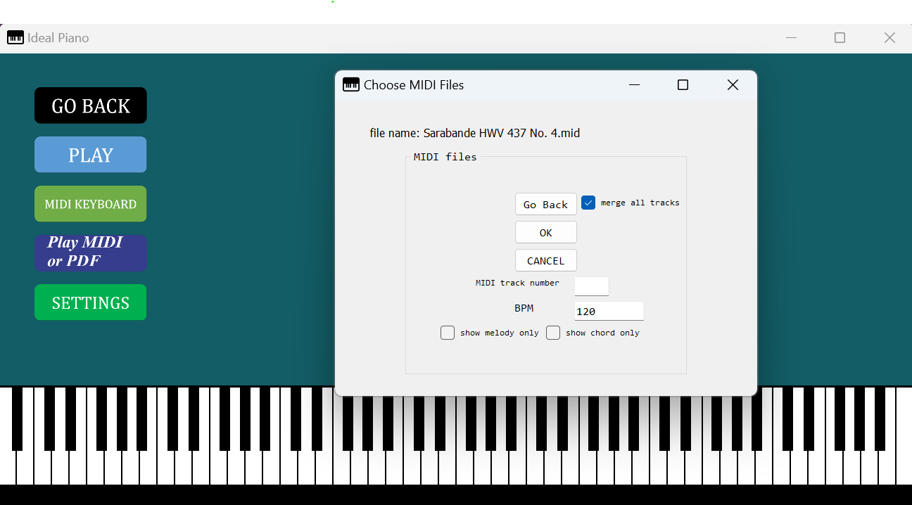
End product
Works as expected
Basic, easy and user-friendly
Could’ve had more features

Slide 20
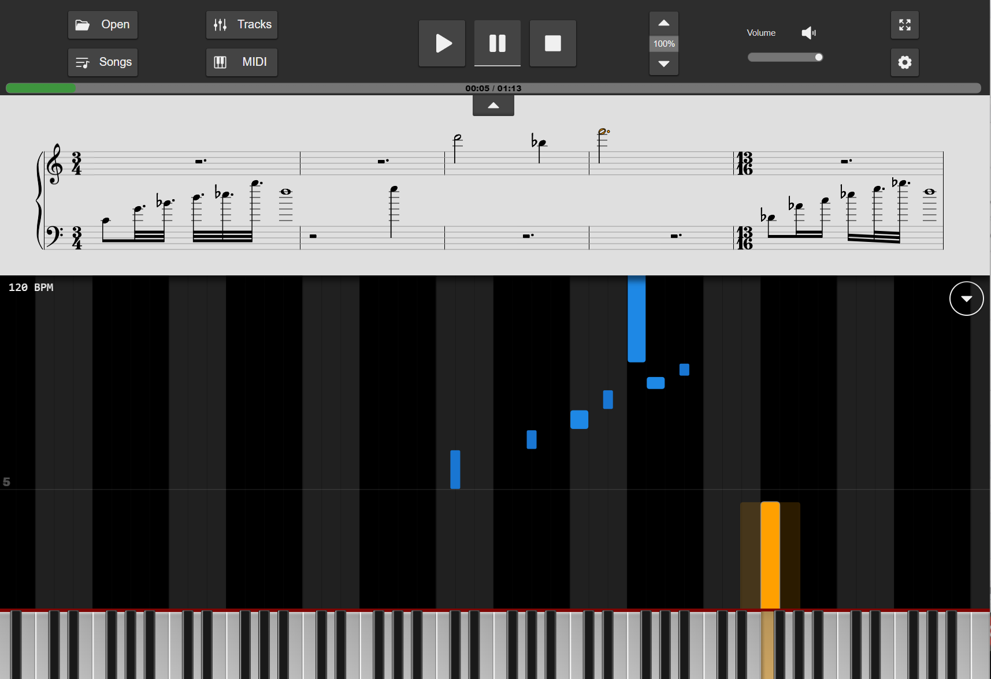
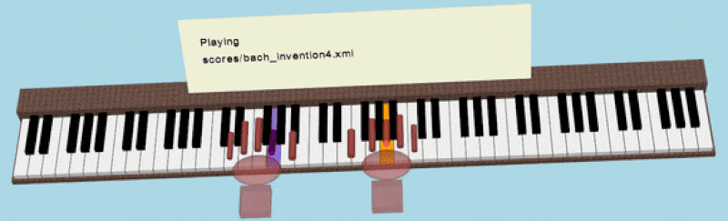
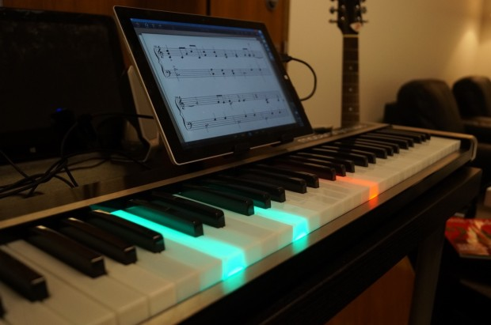
Improvements
Could add more features like a visual sheet, showing both the tiles and notes at the same time
Print out which fingers goes on which keys
IRL feature that highlights the keys

Slide 21
Reflection
Be more pragmatical
Research before committing
Open for new methods/tools
Try to work with what I have

